Slide 1

Advanced database management systems project Mariadb
By:
Priyanka Prabakarrao
Rithika Kandimalla
Sai Surya Prakash Tamminedi
Yesha Desai

Slide 2

Walmart Retail Data Analysis Using MariaDB
Notes:
NOTE:
To change the image on this slide, select the picture and delete it. Then click the Pictures icon in the placeholder to insert your own image.

Slide 3
MariaDB
MariaDB is an open-source relational database management system.
A fork of MySQL created by original MySQL developers.
Designed as a drop-in replacement for MySQL, maintaining compatibility.
Widely used across a variety of applications and industries.

Slide 4
Key features of MariaDB
Open Source and Licensing: Released under the GNU General Public License (GPL).
Compatibility with MySQL: Compatible with MySQL's APIs and command syntax.
Performance Optimization: Focus on high performance and query optimization.
Storage Engines: Supports multiple storage engines for different use cases.
Security and Replication: Enhanced security features and advanced replication options.

Slide 5
Functions of MariaDB
Data Storage: Stores data in structured tables, making it easy to organize and retrieve information.
Data Retrieval: Enables the retrieval of data through SQL queries.
Data Manipulation: Supports CRUD operations (Create, Read, Update, Delete).
Data Security: Provides features like user account management and encryption.
Replication: Supports data replication for high availability and fault tolerance.

Slide 6
How is MariaDB better than other Databases
Database | Feature | Advantage of MariaDB
Oracle DBMS | Closed-source, proprietary | MariaDB is open-source and free to use.
MySQL | Fork of MySQL, compatible with MySQL applications | MariaDB has additional features, such as Galera Cluster.
PostgreSQL | Open-source and high performance | MariaDB is generally considered to be easier to use.
SQLite | Embedded RDBMS | MariaDB is better suited for larger applications.
IBM Db2 on Cloud | Cloud-based version of IBM Db2 | MariaDB is more cost-effective.
Microsoft Azure SQL | Cloud-based version of Microsoft SQL Server | MariaDB is more cost-effective.
Amazon Redshift | Cloud-based data warehouse | MariaDB is designed for transactional applications, while Amazon Redshift is optimized for analytical workloads and data warehousing. .
Redis | In-memory data store | MariaDB can also be used for caching and messaging.
Google BigQuery | Cloud-based data warehouse | MariaDB is more cost-effective
Google AlloyDB for PostgreSQL | Cloud-based version of PostgreSQL | MariaDB is more cost-effective
Amazon Aurora | Cloud-based relational database | MariaDB is more cost-effective

Slide 7
MariaDB vs MySQL
Feature | MariaDB | MySQL
Performance | Faster | Slower
Scalability | More scalable | Less scalable
Security | More secure | Less secure
Community Support | Larger and more active | Smaller and less active
Licensing | Fully open-source | Dual licensing model
Ease of Upgrading | Backward compatible | Not backward compatible

Slide 8
About the Dataset: Walmart Sales Forecast
Aim:
To assess the distribution of store sizes across different store types ('A', 'B', 'C') within Walmart and to understand the influence of markdowns on sales during holiday and non-holiday periods, enabling data-driven decisions to optimize store sizes and markdown strategies for increased profitability. Walmart Dataset: Store - Store number
Date - Week
Temperature - Average temperature in the region
Fuel_Price - Cost of fuel in the region
MarkDown’s - Anonymized data related to promotional markdowns that Walmart is running.
CPI - The consumer price index
Unemployment - The unemployment rate
IsHoliday - Whether the week is a special holiday week Store Dataset
Store - Stores numbered from 1 to 45
Type - Store type has been provided, there are 3 types — A, B and C.
Size - Stores size has provided

Slide 9
Transactional Nature of the product
The database is designed for transactional purposes, handling data such as sales, store information, and markdowns. It supports frequent data updates, including inserts, updates, and deletes. The use of primary keys, foreign keys, and data validation checks ensures data integrity and consistency. The insertion of new records indicates that the database is used to record day-to-day operations.
This database is designed for transactional data and is well-suited for handling the day-to-day operations of a business.

Slide 10
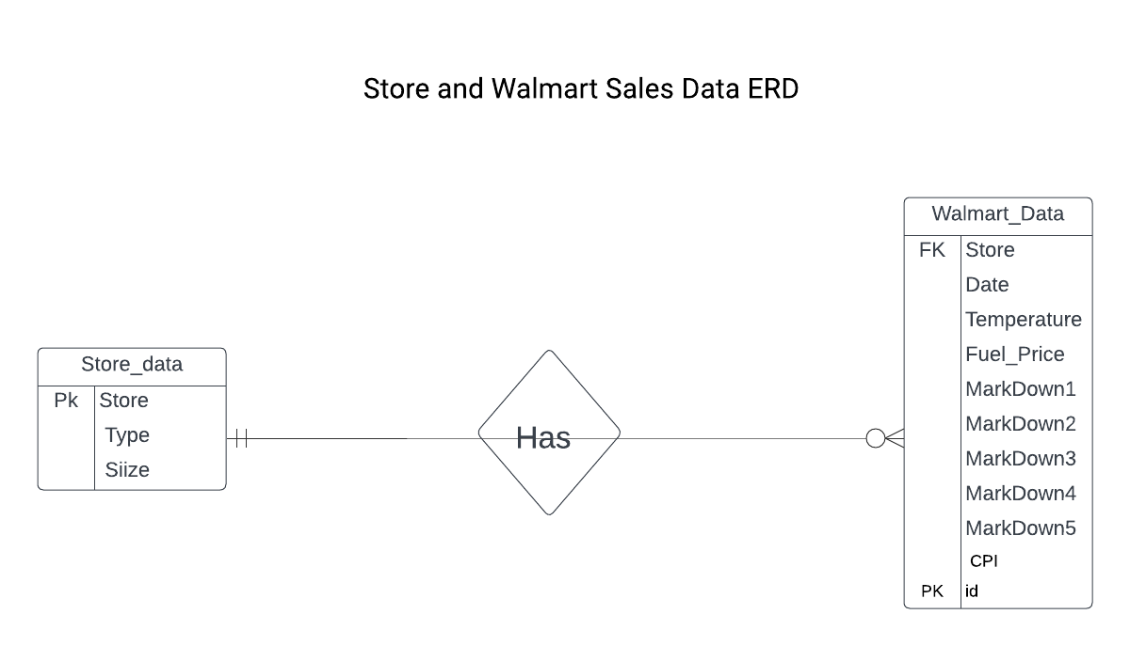
Entity and Relationship Descriptions
Cardinality: Many-to-One (M:1)
Each record in the ‘Walmart_data’ table is associated with one and only one store from the ‘Store_data’ table.
Each store in the ‘Store_data’ table can be associated with multiple records in the ‘Walmart_data’ table.
Modality: Mandatory from the ‘Walmart_data’
Every record in the ‘Walmart_data’ table must be associated with a store in the ‘Store_data’ table. There can be no "orphaned" records in ‘Walmart_data’.

Slide 11
CRUD Operations
CREATE
Store_data Table
Store(PK), Type, Size
Walmart_data Table
id(PK),Store(FK),Date,Temperature,Fuel_Price,Markdown1,Markdown2,Markdown3,Markdown4,Markdown5,CPI,Unemployment,
IsHoliday
READ
SQL INSERT & LOAD DATA LOCAL INFILE are two methods to import data into MariaDB
•SQL INSERT method for few rows
•Two tables are populated using the LOAD DATA LOCAL INFILE
UPDATE
Updated Type for a store and Temperature for a Particular Date using SQL UPDATE Method
DELETE
Deleted few duplicate records in both the tables using DELETE method

Slide 12
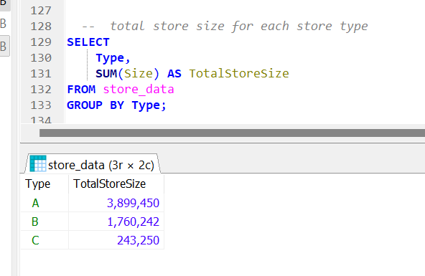
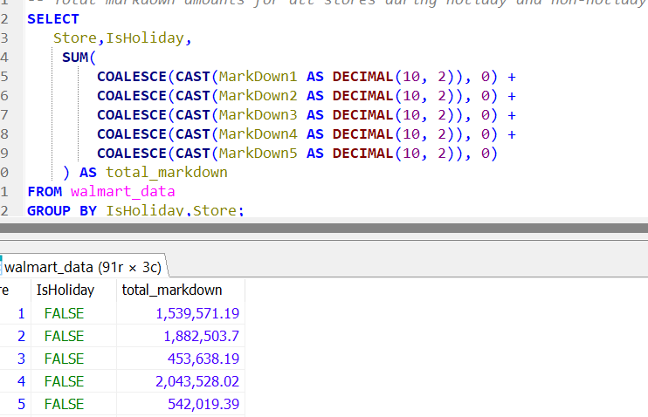
Business Question
What is the total store size for each store type (e.g., 'A', 'B','C')
2. What are the total markdown amounts for all stores during holiday vs non-holiday periods.

Slide 13
Thank you

Slide 14
References
KDD Nuggets Dataset Link: https://www.kaggle.com/datasets/aslanahmedov/walmart-sales-forecast?select=train.csv
https://www.kaggle.com/datasets/aslanahmedov/walmart-sales-forecast?select=stores.csv
https://mariadb.org/
https://mariadb.org/documentation/
Teams Recording link: Team Recording

